Slide 1


Primary BSI & CLABSI in Pediatric Care: Insights, Risk Factors and Predictive Approaches
BZAN 6360 - Capstone Practicum Project course Ⅰ
Team 8
Pavan Kumar Theegela
Jyothika Sakamuri
Taha Mandviwala

Slide 2

PAPER 1- Attributable Cost of Nosocomial Primary Bloodstream Infection in Pediatric Intensive Care Unit Patients
OBJECTIVE & PURPOSE
Nosocomial primary bloodstream infections(BSI) is the most common hospital-acquired infection in PICU patients
The objective of this paper is to determine the attributable cost of nosocomial primary bloodstream infections(BSI) in pediatric intensive care unit(PICU) patients.
Prospective cohort study conducted at St. Louis Children’s Hospital PICU (1999-2000).

Slide 3


DATA SOURCE
All patients who were admitted to the PICU were considered.
Exclusion Criteria: age>18 years, death within 24 hours of PICU admission, admission to the NICU service.
Patients were divided into two groups: those with bloodstream infections (BSI) and those without.
There were 911 PICU admissions in the mentioned timeline, and 78% of them are whites,58%of them are male, and more than half of the population are younger than 3 years.

Slide 4
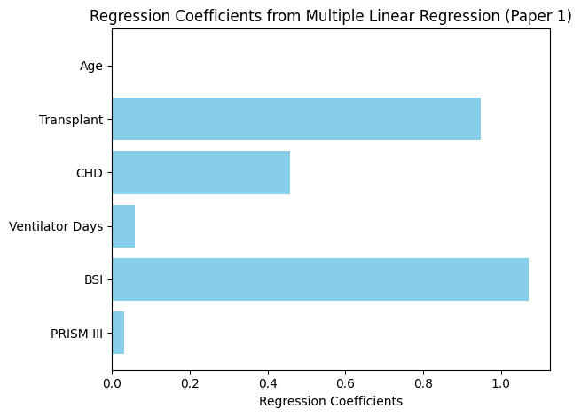
STATISTICAL ANALYSIS
Multiple linear regression was used to control for factors such as:
Age
Severity of illness(PRISM ⅠⅠⅠ score)
Underlying diseases(Congential heart,lung disease)
Transplant
Nosocomial primary BSI
Ventilator days
Nosocomial primary BSI has highest significance

Slide 5

KEY TAKEAWAYS
57 children developed 65 episodes of bloodstream infections.
The rate of BSI in this population was 13.8 per 1000 central venous catheter days.
The prevention of these infections through specific interventions is likely to be cost-effective.
RESULTS
Direct cost of PICU admission for patients with BSI: $45,615.
Direct cost for patients without BSI: $6,396.
Attributable cost: $39,219 per BSI case.

Slide 6
PAPER 2 - Risk Factors for Central Line-Associated Bloodstream Infection (CLABSI) in Pediatric Intensive Care Units
OBJECTIVE & PURPOSE
CLABSI significantly impacts pediatric ICU care, increasing hospital costs, length of stay, and mortality.Identify risk factors to optimize prevention strategies, reducing costs and improving patient care.

Slide 7
Data Source and business angle: The study used retrospective data from Boston Children’s Hospital (2004-2007), including ICU stays, catheter usage, and patient outcomes. Identifying CLABSI risk factors enables targeted prevention, reducing ICU costs and improving care quality. Developing predictive models helps hospitals make data-driven decisions for better resource allocation and financial efficiency.
203 406
Case Patients Control Patients

Slide 8
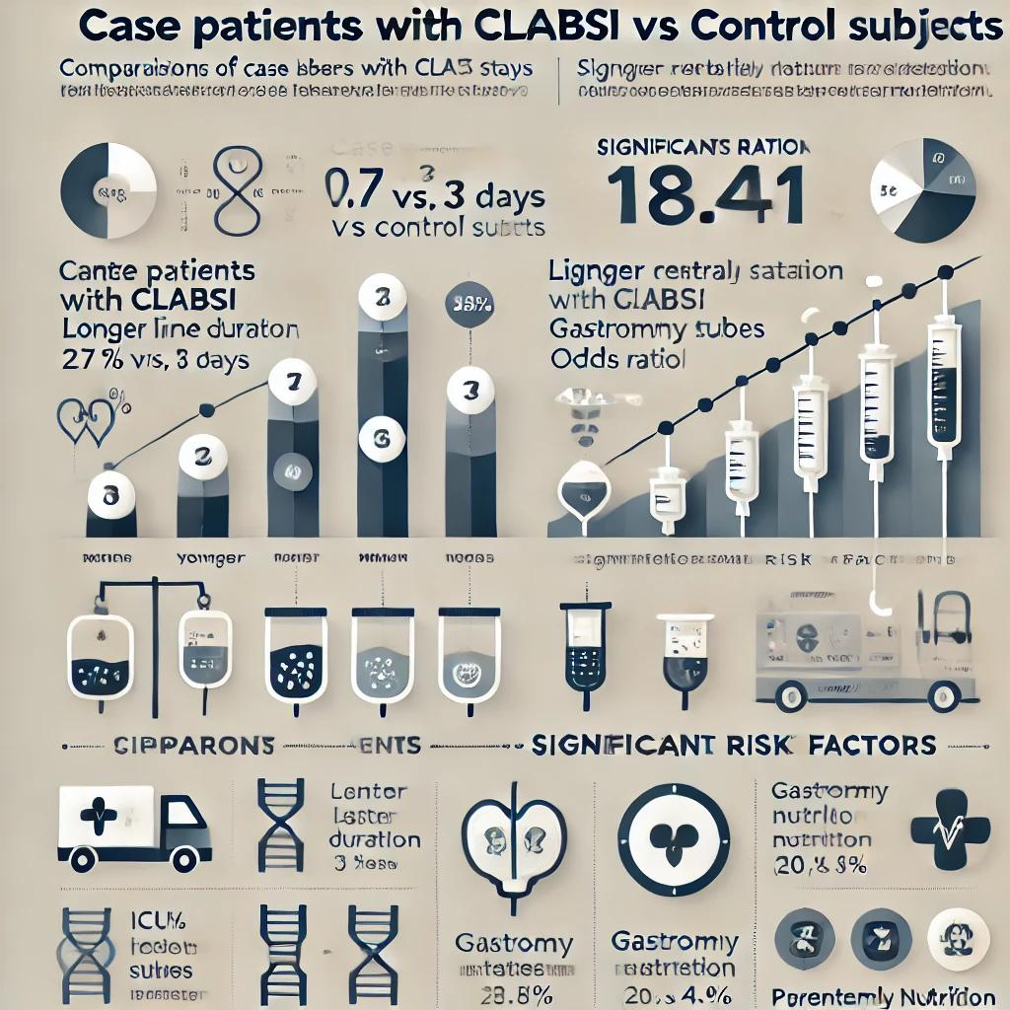
STATISTICS AND FINDINGS
POINT 03
The statistical analysis found that case patients with CLABSI were younger (median age 0.7 vs. 3 years), had longer ICU stays (27 vs. 3 days), and higher mortality (20.7% vs4.9%) compared to controls. Key risk factors identified were prolonged central line duration (OR 18.41), ICU catheter placement (OR 8.63), and gastrostomy tubes (OR 3.48). The findings emphasize that targeted prevention strategies for high-risk patients can improve outcomes and reduce costs.
COMPETITOR 02

Slide 9
IMPLICATIONS AND RECOMMENDATIONS:
The findings have significant clinical implications, suggesting targeted preventive strategies like improved catheter protocols to reduce CLABSI Implementing these strategies can enhance patient outcomes, optimize resource use, and lead to cost savings in ICU operations. The predictive model provides a data-driven approach to identifying high-risk patients.

Slide 10


RESULT AND CONCLUSIONS
The study identified key risk factors for CLABSI, such as prolonged central line use and ICU catheter placement, which impact ICU stay and mortality. Targeted prevention can reduce infection rates and costs, while the predictive model aids in early identification of high-risk patients. Implementing these findings improves care quality and optimizes resource use in pediatric ICUs.

Slide 11
Predicting Central Line Associated Bloodstream Infections using Machine Learning - Paper 3
INTRODUCTION
OBJECTIVE & PURPOSE
Nosocomial bloodstream infections in ICUs had a high mortality rate (35%) in the 1990s, doubling ICU stays.
Despite improvements, around 30,100 CLABSIs still occur annually in the U.S.
Machine learning offers a new approach to predicting complex medical outcomes, with the potential to outperform traditional statistical methods.
This study aims to use supervised machine learning to predict central line placement, CLABSI, and mortality in ICU patients.

Slide 12
MATERIALS METHODS & DATA SOURCE
Data came from the MIMIC-III database, which includes 46,520 admissions at Beth Israel Deaconess Medical Center (2001-2012).
The study focused on first ICU admissions, calculating six severity of illness scores and 30 Elixhauser comorbidities.
The study analyzed three outcomes: mortality, central line placement, and CLABSI.
Three machine learning classifiers were used: logistic regression, gradient boosted trees, and deep learning.

Slide 13
CHALLENGES
Predicting CLABSI remains complex due to the multifactorial nature of infections.
Data limitations, like reliance on ICD-9 codes, introduced potential biases.
Our logistic regression models underperformed, revealing the need for better parameter optimization.

Slide 14
STATISTICS RESULTS
38.4%
18%
1.5%
16.2%
Hospital Admissions and Central Line Stats:
Mortality With and
Without Central Line
Central Line Patients
With Central Line Patients
10.1%
6.2%
CLABSI
Patients
Without Central
Line
Mortality Rate
Patients with CLABSI

Slide 15
MODEL PERFORMANCE
& CONCLUSION
Logistic Regression
CLABSI
Gradient Boosted Trees
CENTRAL LINE
Deep Learning
Gradient Boosted Trees
Logistic
Regression
Deep Learning
MORTALITY

Slide 16
 | Paper -3 | Paper -2 | Similarities
Objective | Identify and predict risk factors for CLABSI in ICU settings using advanced analytics. | Identify specific risk factors for CLABSI in pediatric ICUs to enhance prevention. | Both aim to improve ICU outcomes by identifying and predicting CLABSI risk factors.
Study Design | Retrospective observational study using MIMIC-III database for broader ICU data. | Retrospective case-control study focusing on pediatric ICU population. | Both use a retrospective design to analyze patient data related to CLABSI.
Analytical Approach | Employs machine learning models for predictive analytics. | Utilizes univariate and multivariate statistical regression. | Both employ data-driven approaches: Paper 2 uses machine learning, Paper 3 uses statistical regression.
Outcome Focus | Aims to enhance predictive accuracy for CLABSI and reduce associated healthcare costs. | Targets identification of key risk factors for tailored prevention and improved patient outcomes. | Both focus on improving patient care by reducing CLABSI incidence and related costs.
Data Analysis | Uses logistic regression as part of a broader machine learning approach. | Uses logistic regression to assess independent predictors of CLABSI. | Both papers use logistic regression for risk assessment and model development.
Implications For Patient Care | Provides insights for targeted preventive measures to optimize ICU resources. | Results aim to improve CLABSI prevention strategies and resource allocation in pediatric ICUs. | Findings from both papers guide preventive strategies to optimize ICU care and resource use.

Slide 17


THANK YOU!

